Slide 1
BSBCRT404
Decision Making Framework
Don Damov

Slide 2
Decision Making Framework
What is it?
A process or series of stages to sequentially go through in order to ultimately make a decision, ensuring that the best ideal outcome be reached by implementing critical thought processes / analysis wherever possible.
Why do it?
To ensure the best possible decision be made, based on all possible evidence / information.
Don Damov

Slide 3
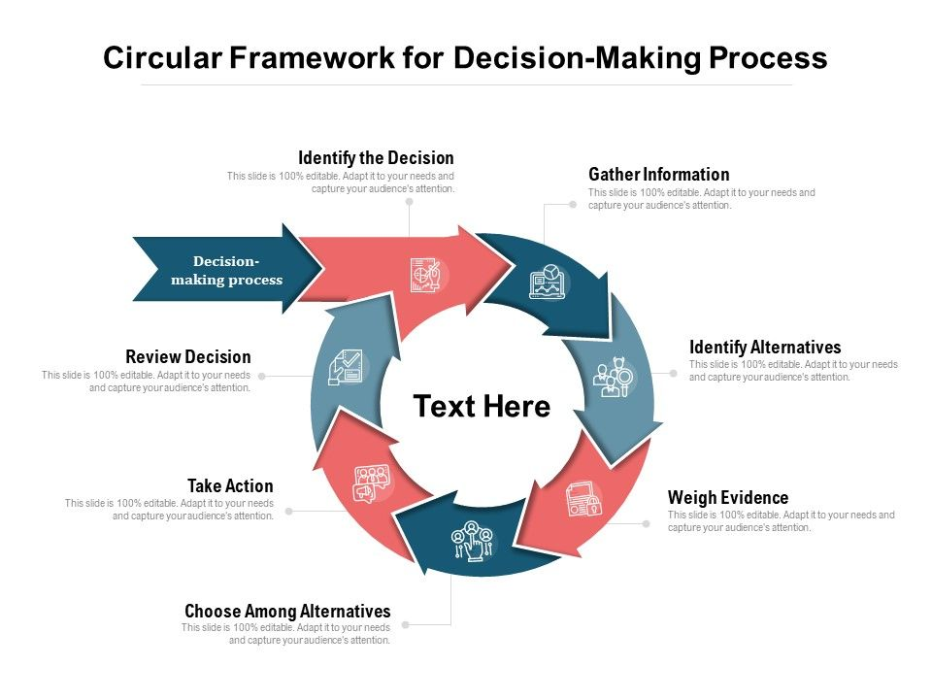
The Decision Making Framework Cycle
Frensch, Peter A.; Funke, Joachim, eds. (1995). Complex problem solving: the European perspective. Hillsdale, NJ
Scenario Example:
Catering for a Poker Night
Don Damov

Slide 4
1. Identify the Decision
What needs to be decided?
Catering for Poker Night
What is the decision ultimately for?
Feed the Participants of the event
What is your initial decision?
Pizza
Why did you come up with this decision?
Because in my opinion, it’s the best takeaway option
Don Damov

Slide 5
2. Gather Information
What information surrounds this decision?
Guests will be hungry
Guests need to eat
Everyone’s “cool with whatever”
What are the decision conditions / restrictions?
No food allergies
Must be satisfying
Don Damov

Slide 6
3. Identify Alternatives
Identify all possible options
Alternative take-away options
Cooking instead / barbeque
Everyone bring along something / family style
Practice Fasting
Mind Map 👍
Don Damov

Slide 7
4. Weigh Evidence
Pro’s & Cons for all Options / Alternatives
Pizza
Pro:
Tasty and Satisfying
Con:
Heavy and Un-healthy
Cooking / Barbeque
Pro:
More Variety, Healthier
Con:
More effort, Time consuming for me
Everyone bring along something / Family stye
Pro:
More Variety, Possibly Healthier
Con:
More effort, Time consuming for everyone
Practice Fasting
Pro:
Healthiest option
Con:
It’ll be the last Poker night I host
Don Damov

Slide 8
5. Choose Among Alternatives / Options
Prioritise Essential Pro’s
Taste
Convenience
Satisfaction
Identify which alternative meets more of the essential criteria of the decision
Pizza
Don Damov

Slide 9
6. Take Action
Once all possible evidence is presented and reviewed make the decision.
Proceed with the order
Don Damov

Slide 10
7. Review Decision
What went Well?
Pizza was all gone, everyone was satisfied
What went Wrong?
One comment on them breaking their diet and feeling guilty
Review the steps 4 & 5, would any worked better?
Nope
What would you have done differently / do next time?
Put pressure on guests to give actual opinions / preferences on food
Don Damov

Slide 11
End Goal / Outcome
A Logical Decision
The best possible decision that can be made from any and all possible sources of information, and reviews of any and all possible alternatives.
Research and Analysis using Critical Thinking.
A Defensible Conclusion
If evidence is ever required to demonstrate how a decision is made, you have all the evidence present if correctly recorded / developed within the cycle.
Like showing a Mathematical answer with the equation / working out.
Don Damov

Slide 12
Questions & Answers?
Don Damov

